Slide 1
Maschine Learning - Introduction

Slide 2
Framing
Data
Result
{marketing expenses / month}
revenue / month
{age, gender, #lecture attendance }
exam grade

Slide 3
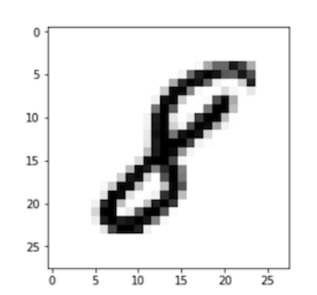
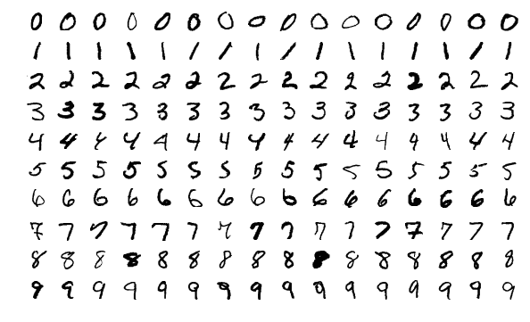
MNIST Data Set (https://en.wikipedia.org/wiki/MNIST_database)
Data
Result
8
Image by Josef Steppan - Own work, CC BY-SA 4.0, https://commons.wikimedia.org/w/index.php?curid=64810040

Slide 4


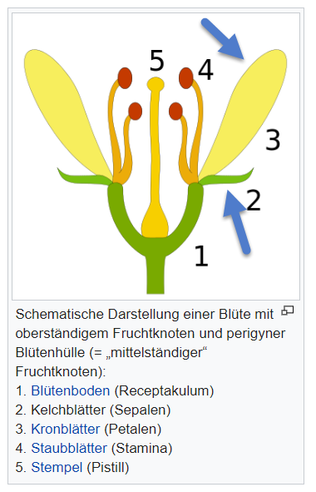
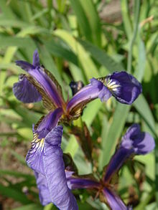
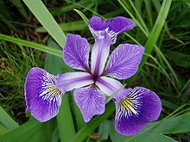
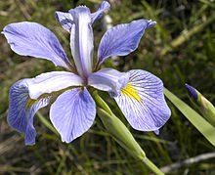
Iris Data Set (https://en.wikipedia.org/wiki/Iris_flower_data_set)
Data
Result
https://de.wikipedia.org/wiki/Kelchblatt
Iris Setosa
Iris Versicolor
Iris Virginica

Slide 5
How Machine Supervised Learning works
Give me lots of data (dataset)
… and their correct results
ML
nbs Data
Algorithm
Result
ML will find an algorithm to calculate results on never before seen data.

Slide 6
Backup

Slide 7
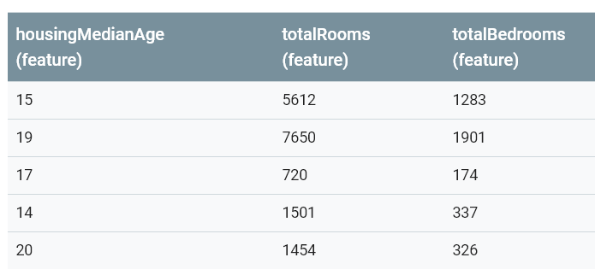
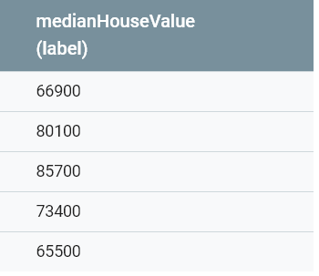
Framing
Data
Algorithm
Result
Source: California housing data set, which contains data drawn from the 1990 U.S. Census.

Slide 8
Framing
Data
Algorithm
Result
marketing expenses / month
revenue / month
{age, gender, #lecture attendance }
exam grade
Source: California housing data set, which contains
data drawn from the 1990 U.S. Census.

